Slide 1
Predicting Fraudulent Claims in Automotive Insurance By Leveraging Machine Learning
Presented by
Manu M L
Trainee Data Scientist at Turing Minds.AI

Slide 2
Content
Case Introduction
ML Problem Statement
Data Exploration and Visualization
Data Pre-processing
Important Features
Models
Validation and Parameter Tuning
Conclusion

Slide 3
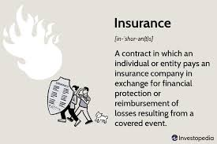
Case Introduction
The global insurance market grew at a rate of 450 billion dollars from 2021 to 2022
Types Of available insurances: Health Insurance, Motor Insurance, Home Insurance, Fire Insurance
Major Challenges faced by the sector: Customer retention, Rising operation costs, Fraudulent claims and many more.
The companies have lost $6.25 billion due to Fraudulent claims.

Slide 4
ML Problem Statement
The problem
Why does it need to be solved?
Why ML?

Slide 5
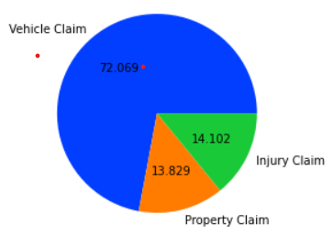
Data Exploration and Visualization
Given datasets: Claim data, Customer details, Policy data, Vehicle details and Reported Frauds.
Using Visualization tools to:
Understand data distribution
Obtain insights and traits
Identify features that are important that might have major influences

Slide 6
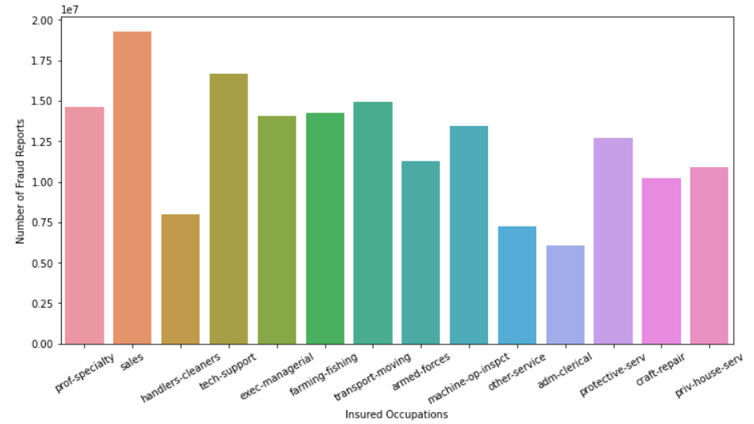
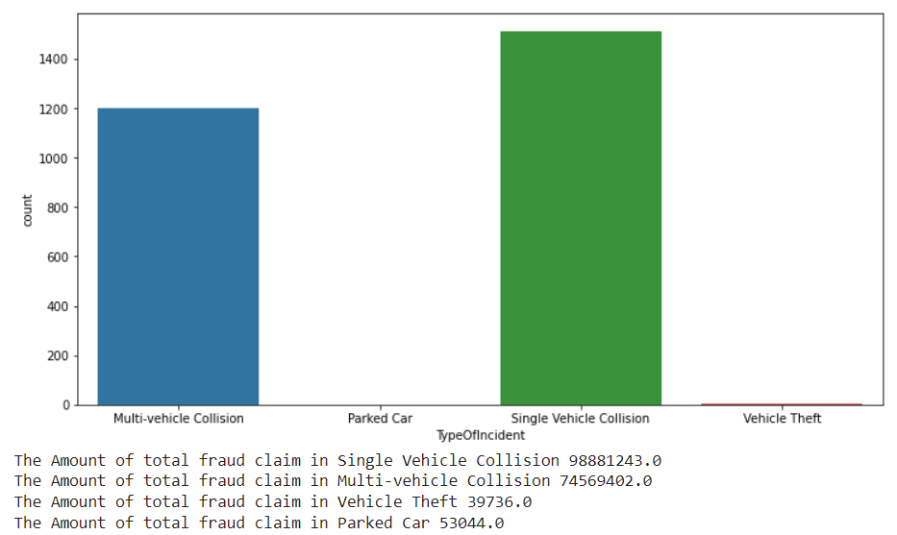
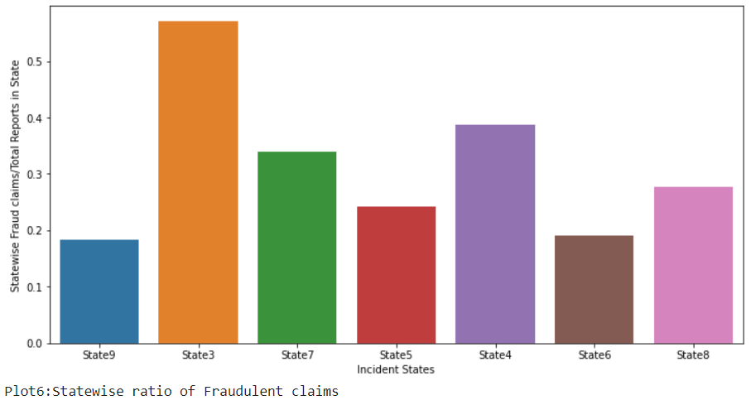
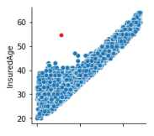
Customer Loyalty Period

Slide 7
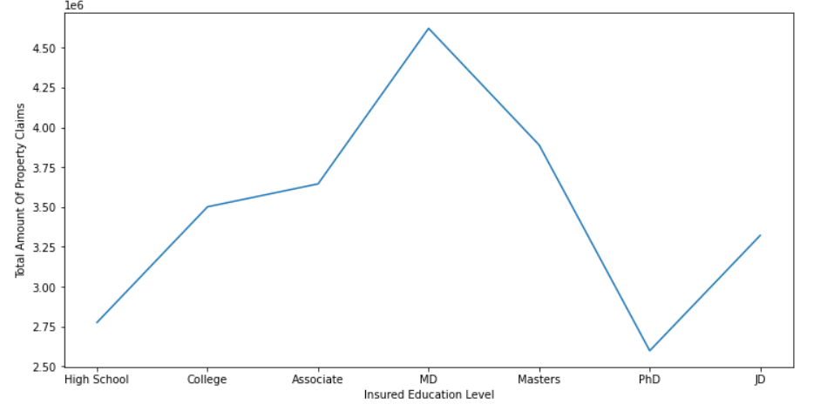
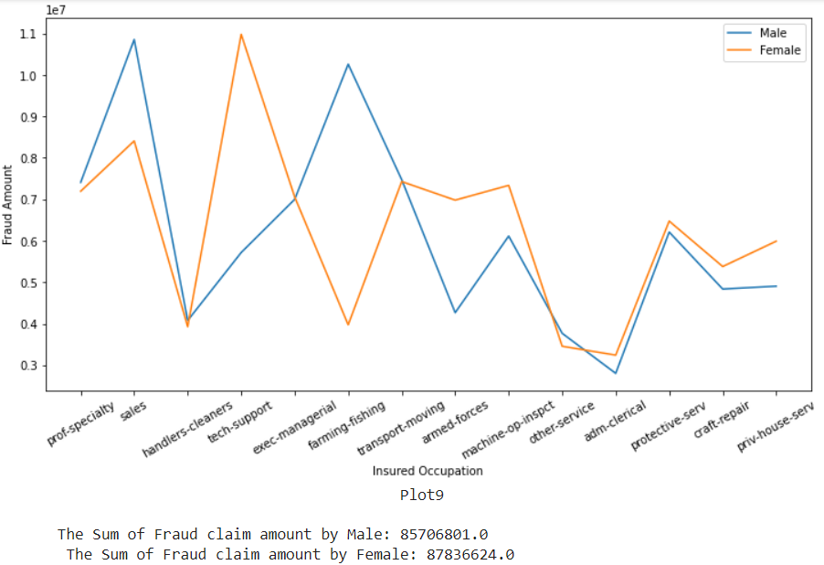
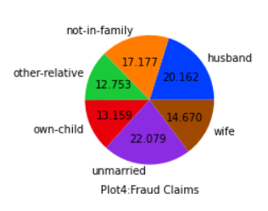

Slide 8
Data Pre-processing
Steps | Methods
Missing Value Treatment | Simple Imputer: mode Iterative Imputer
Outlier Detection | Flooring Multiplication with -1
Feature Engineering | Delta Days
Feature Transformation | Numerical to Categorical: Binning Categorical to Numerical: Response Encoding, One Hot Encoding
Feature Scaling | Robust Scaler
Feature Selection | ANOVA F-value

Slide 9
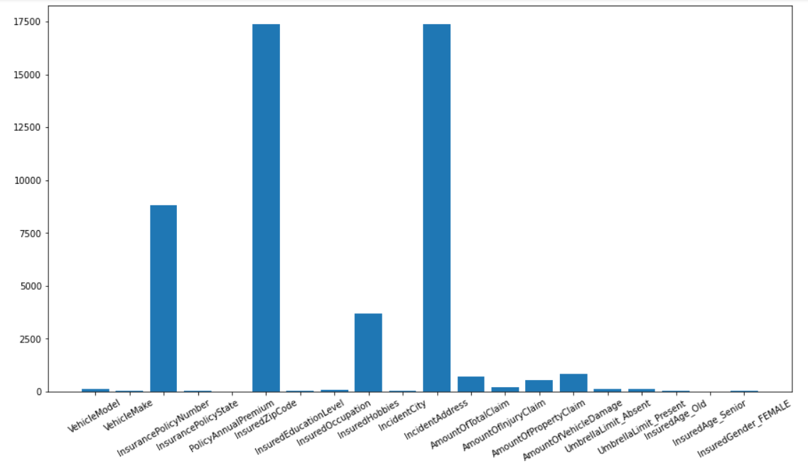
Important Features

Slide 10
Models
Logistic Regression
Decision Tree Classifier
Random Forest Classifier
Light Gradient Boost Classifier
Voting Classifier : KNN, Decision Tree, Logistic Regression, Gaussian Naïve Bayes, SVC

Slide 11

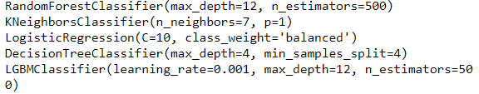
Validation and Parameter Tuning

Slide 12
Conclusion
Model Summary
Estimator | F1 score(Validation) | Run Time | ROC_AUC score | Test Score
Logistic Regression | 0.9380 | 00.3475s | 0.9060 | 0.68
Decision Tree Classifier | 0.8839 | 00.1397s | 0.9329 | 0.7
Random Forest Classifier | 0.9413 | 14.1836s | 0.9305 | 0.84
LGBM Classifier | 0.9422 | 10.0978s | 0.9327 | 0.82
Voting Classifier | 0.9418 | 259.5843s | 0.9289 | 0.83
The model was able to predict fraudulent claims with 94% accuracy on the train data and F1 score of 0.84 on unseen test data
Genuine claims = 2065/2105 (predicted/actual)(train data)
Fraudulent claims = 655/779 (predicted/actual)(train data)

Slide 13
Conclusion : Recommendations to Business
To have thorough verification of background for the claims in the name of “Husband” and “unmarried”.
Higher the age of the customer more is the loyalty period and hence are to be given more importance compared to younger ones.
To re-evaluate the amount that can be claimed under Minor damage as there are claims that are worth more than those from Major damage and Total Loss.
To examine the claims thoroughly from customers working in Sales, Transport-moving and tech-service.
To have a thorough check on claims when the Incident State is State3 followed by State4.

Slide 14
Conclusion
What more could have been done?
A further detailed study and discussion with the domain expert regarding the given features might have helped to understand the dataset better and also would have been useful for feature engineering.

Slide 15
Thank You

